Slide 1
EE224 Signals and Systems I
Lab 3
Signals with Time-Varying Frequency

Slide 2
Time-Varying Frequency
Frequency can change vs. time
Continuously, not stepped
FREQUENCY MODULATION (FM)
CHIRP SIGNALS
Linear Frequency Modulation (LFM)
VOICE

Slide 3
New Signal: Linear FM
Called Chirp Signals (LFM)
Quadratic phase
Freq will change LINEARLY vs. time
Example of Frequency Modulation (FM)
Define “instantaneous frequency”
QUADRATIC

Slide 4
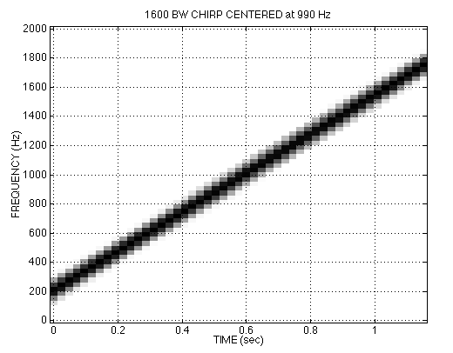

CHIRP SPECTROGRAM

Slide 5
INSTANTANEOUS FREQ
Definition
For Sinusoid:
Derivative
of the “Angle”
Makes sense

Slide 6
INSTANTANEOUS FREQ of the Chirp
Chirp Signals have Quadratic phase
Freq will change LINEARLY vs. time

Slide 7
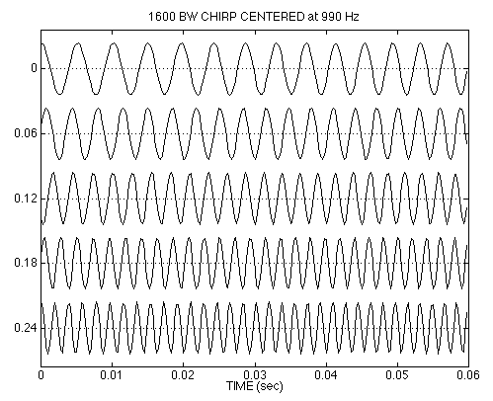
CHIRP WAVEFORM

Slide 8
OTHER CHIRPS
ψ(t) can be anything:
ψ(t) could be speech or music:
FM radio broadcast

Slide 9
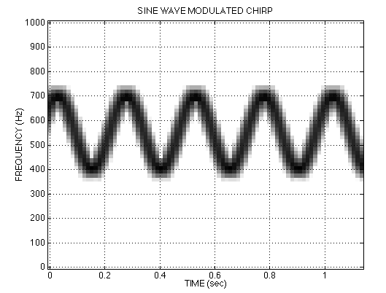
SINE-WAVE FREQUENCY MODULATION (FM)

Slide 10
Natural Chirps
Interesting chirps occur in nature
Bats use chirp for echolocation
http://www.bio.bris.ac.uk/research/bats/calls/
See batdetective.org for spectrograms and sample signals- you can help identify!
Dolphins and Killer Whales for communication and echolocation
Radar systems use chirp for more precise distance estimation

